Slide 1
Prognostication
Supplement to VA Goals of Care Conversations Training Materials
Developed January 2017

Slide 2
Learning Objectives
Describe the disease trajectory of advanced malignant disease.
Describe the disease trajectory of advanced non-malignant disease.
Name two prognostic markers in advanced malignancy, and one in a non-malignant disease.

Slide 3
Malignant diseases - What are the indicators?
Performance status
Oral intake
Edema
Dyspnea
Delirium
WBC count
%lymph
Clinician’s estimation
Notes:
The single most important predictive factor in cancer is Performance Status also known as Functional Ability; a measure of how much a patient can do for themselves, their activity and energy level. Patients with solid tumors typically lose ~ 70% of their functional ability in the last 3 months of life. The most common scales used to measure functional ability are the Karnofsky Index (100 = normal; 0 = dead) and the ECOG scale (Eastern Cooperative Oncology Group), (0 = normal; 5 = dead). A median survival of 3 months roughly correlates with a Karnofsky score <40 or ECOG > 3. Newer prognostic scales have been developed to help provide prognostic information (See Fast Fact #124, 125).The simplest method to assess functional ability is to ask patients: How do you spend your time;, How much time do you spend in bed or laying down? If the response is >50% of the time, and is increasing, you can roughly estimate the prognosis at 3 months or less. Survival time tends to decrease further when there are increasing number of physical symptoms, especially dyspnea, if secondary to the cancer.

Slide 4
Common cancers 2010
ResponseRate Median Duration Median Survival
Breast 25-55% 6-12 months 24-36 months
Colon 25-35% 6-8 months 12-18 months
Esophagus 30-50% 4-6 months 6-9 months
Lung (Non-Small Cell)20-30% 4-6 months 6-9 months
Stomach 20-50% 4-6 months 6-12 months
Melanoma 15-25% 4-6 months 6-9 months
Pancreas 10-25% 3-5 months 6-9 months
Liver (Hepatocellular) 5-15% 2-4 months 6-9 months
Biliary (Cholangio) 15-25% 2-4 months 6-9 months

Slide 5
Malignant diseases - Specific solid cancer syndromes
Malignant hypercalcemia – 8 weeks
Malignant pericardial effusion – 8-12 weeks
Carcinomatous meningitis – 8-12 weeks
Multiple brain metastases – 4-8 vs 3-6 months
Malignant ascites, malignant pleural effusion, or malignant bowel obstruction – <6 months
Notes:
Calcium-: 8 weeks (except newly diagnosed breast cancer/myeloma)
8-12 weks for top three
Brain mets 1-2 months with xrt and 3-6 with
Final nmber < 6 months

Slide 6
A simple model
Karnofsky Performance Status
> 60 0
<60 (considerable assistance & frequent medical care) 3
Mets
Bone 0
Other 2
Cancer
Breast 0
Prostate 2
Lung and other 3
Notes:
KPS: Karnofsky Performance Status Scale
http://www.hospicepatients.org/karnofsky.html

Slide 7
A simple model
A 0-4
Median survival 60 weeks
B 5
Median survival 26 weeks
C 6-8
Median survival 10 weeks

Slide 8
Changes over the last 5 years
Lung cancer from <6 months to 2-3 years
Colon cancer with mets from <6 months to 2-4 years
The advent of immunotherapies and the change in chemotherapy toxicity
The lack of data regarding their impact with low functional status

Slide 9
Malignant Diseases- Prognostic scales
Palliative Prognostic Index (PPI)
Palliative Prognostic (PaP) Score
Palliative Performance Scale (PPS)

Slide 10
Prognosis in elderly
EPrognosis.com
Models for 1 year
male sex (1 point); number of dependent ADLs at discharge (1-4 ADLs, 2 points; all 5 ADLs, 5 points); congestive heart failure (2 points); cancer (solitary, 3 points; metastatic, 8 points); creatinine level higher than 3.0 mg/dL (265 μmol/L) (2 points); and low albumin level (3.0-3.4 g/dL, 1 point; 3.0 g/dL, 2 points)
Models for 4 years
age, sex, self-reported comorbid conditions, and functional measures

Slide 11
Non-Malignant Diseases: Natural History

Slide 12
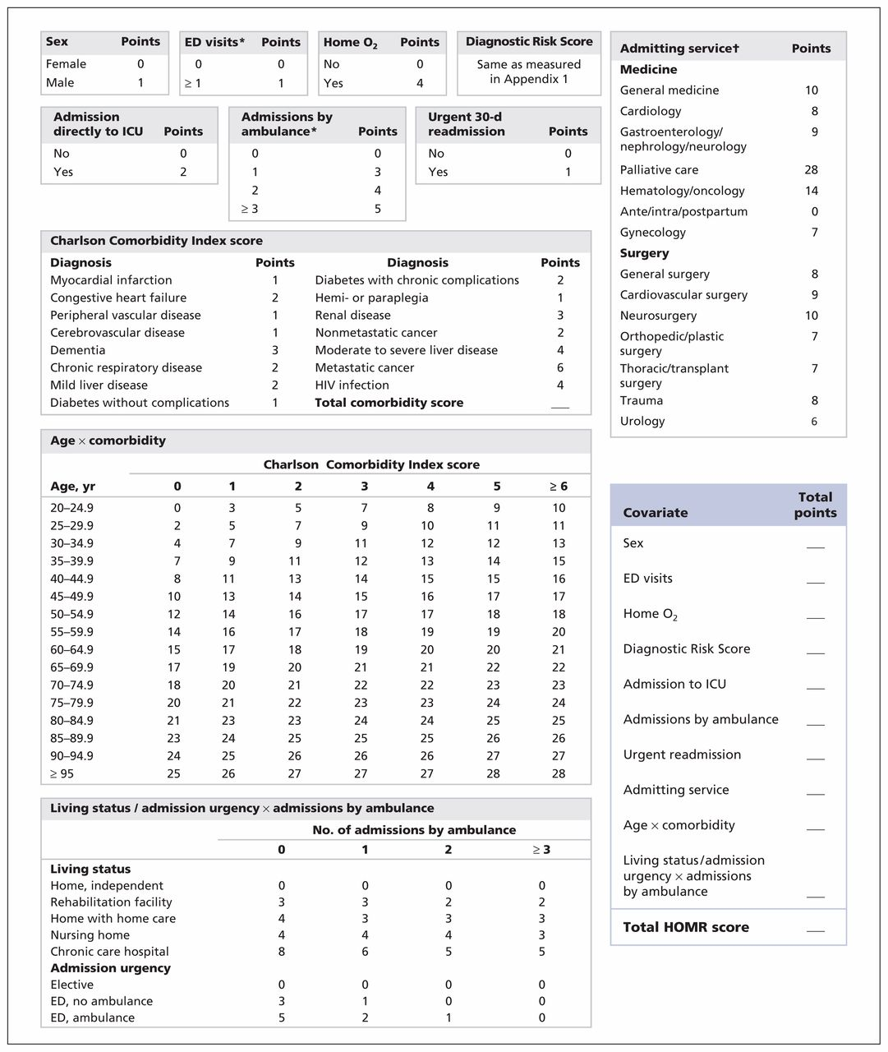
Covariates used to calculate a patient’s Hospital-patient One-year Mortality Risk (HOMR) score at the time of admission to hospital
©2015 by Canadian Medical Association
Carl van Walraven et al. CMAJ 2015;187:725-733
Notes:
Covariates used to calculate a patient’s Hospital-patient One-year Mortality Risk (HOMR) score at the time of admission to hospital. The Diagnostic Risk Score (Appendix 1) quantifies risk of death for diagnostic groups beyond that explained by the other covariates. Points for the interacting covariates of age and Charlson Comorbidity Index score include the risk of patient age, comorbidity score and their interaction. In contrast, points for living status and admission urgency include the risk of these covariates and their interaction with admissions by ambulance in the previous year; points for the latter covariate are considered separately. See Table 3 for the expected risk of death within 1 year after hospital admission for each HOMR score. ED = emergency department, ICU = intensive care unit. *In the year before admission. †See Appendix 2 for definitions of each service. (Appendices are available at www.cmaj.ca/lookup/suppl/doi:10.1503/cmaj.150209/-/DC1)‏

Slide 13
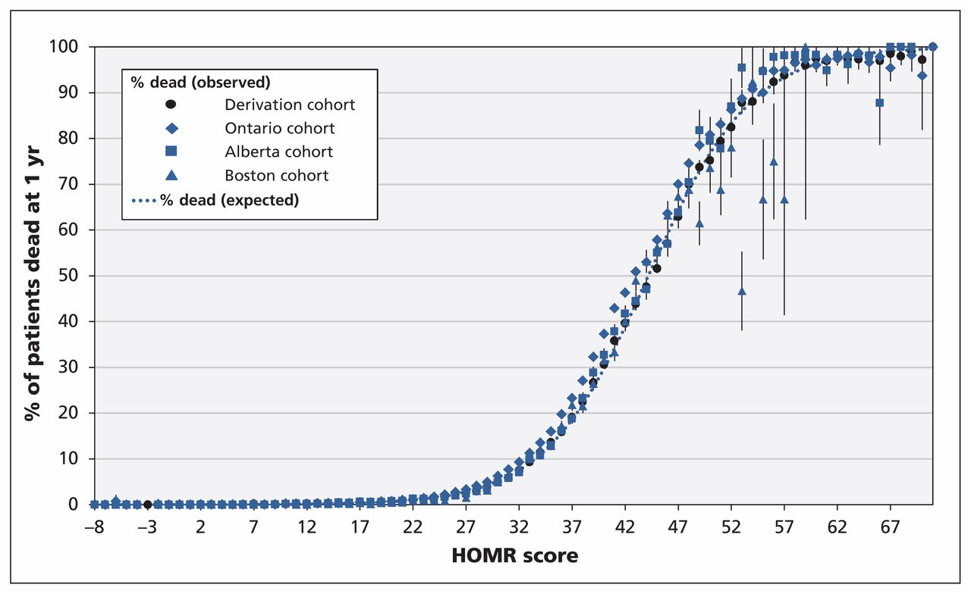
Observed and expected risks of death within 1 year after admission to hospital in the 3 validation cohorts (Ontario, Alberta and Boston) and the derivation cohort,1 as calculated by the Hospital-patient One-year Mortality Risk (HOMR) model.
Carl van Walraven et al. CMAJ 2015;187:725-733
©2015 by Canadian Medical Association
Notes:
Observed and expected risks of death within 1 year after admission to hospital in the 3 validation cohorts (Ontario, Alberta and Boston) and the derivation cohort,1 as calculated by the Hospital-patient One-year Mortality Risk (HOMR) model. Error bars indicate 95% confidence intervals. A summary of the calibration of each cohort to the expected risk of death is given in Table 2.

Slide 14
Other Models: Silver Code, CARING, BISEP, SUPPORT, Levine et al, MPI, HELP, Walter et al, HOMR

Slide 15
Heart Failure: What are the indicators?
Recent cardiac hospitalization (triples 1-year mortality)
Cachexia
Reduced functional capacity
Resource: www.seattleheartfailuremodel.org

Slide 16
End-Stage Liver Disease- What are the indicators?
Compensated or decompensated cirrhosis
Child’s class- best indicator
Hepatorenal syndrome
GI Bleed
MELD- objective, used for transplant listing
Hyponatremia

Slide 17
CHILD’s Classification

Slide 18
Child’s and prognosis
 | 1 year | 2 year | NOTE
A (5-6) | 95 | 90
B (7-9) | 80 | 70
C (10-5) | 45 | 38 | 10% if in ICU 5% if renal failure

Slide 19
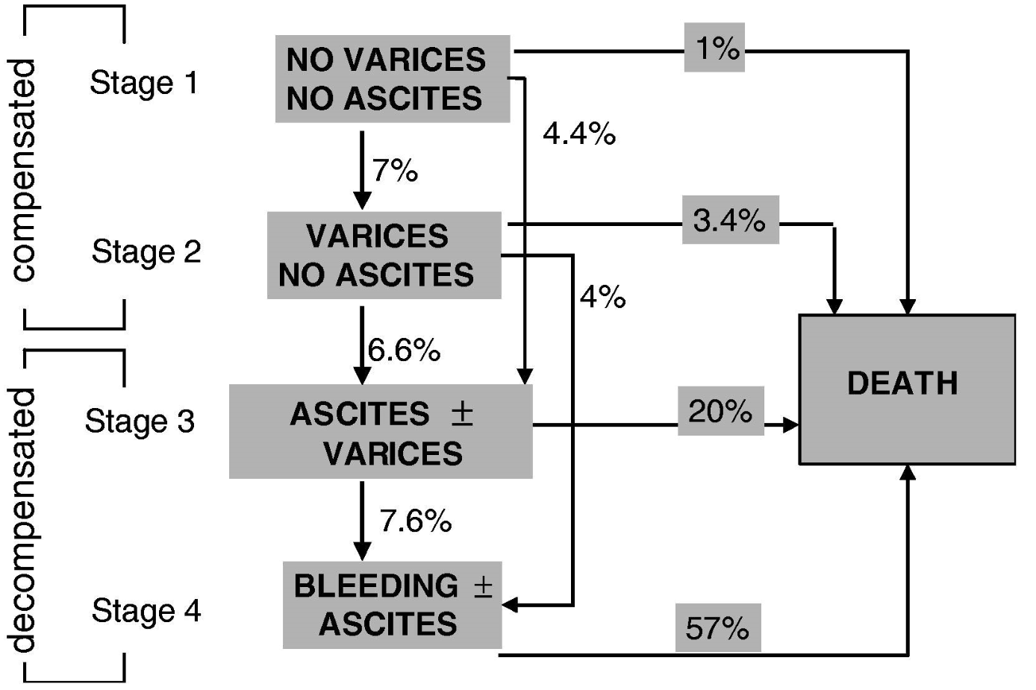
Liver Disease: The Importance of Compensation
https://doi.org/10.1016/j.jhep.2005.10.013

Slide 20
MELD and prognosis
https://www.unos.org/transplantation/allocation-calculators/

Slide 21
End-Stage Liver Disease: The Indicators
Compensated cirrhosis
<10% 1-yr mortality
Decompensated cirrhosis
<40% 1-yr mortality
Child’s class
55% 1yr mortality- Childs C
HRS
>90% in-hospital mortality
GI Bleed
57% 1-yr mortality
most deaths within 6 weeks of bleed

Slide 22
Dementia: What are the indicators?
ADLs
Functional capacity
Comorbidities

Slide 23
Miscellaneous Markers
Stopping Dialysis = 7-14 days
Not eating/no tube feeding = weeks - months
Not drinking/no IVFs = weeks

Slide 24
Credits
Goals of Care Conversations training materials were developed and made available for public use through U.S. Department of Veterans Affairs contracts with VitalTalk
[Orders VA777-14-P-0400 and VA777-16-C-0015].
Materials are available for download from
VA National Center for Ethics in Health Care at
www.ethics.va.gov/goalsofcaretraining.asp.

