Slide 1
Why communication skills training?

Slide 2
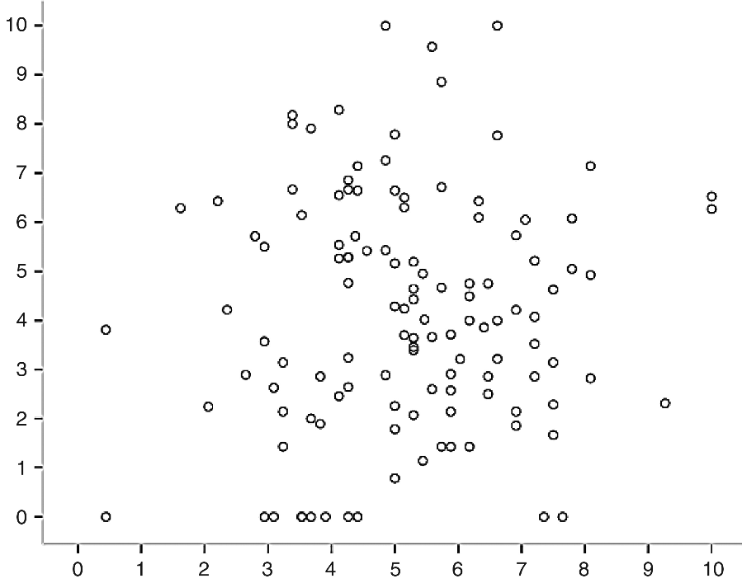
Our self-assessments of communication skills need calibration
Patient-rated
competence
Clinician self-rated competence
J Palliat Med 2012(4); 15: 418-426.
Notes:
Internal Medicine Trainee Self-Assessments of End-of-Life Communication Skills Do Not Predict Assessments of Patients, Families, or Clinician-Evaluators.
Robert P. Dickson, Ruth A. Engelberg, Anthony L. Back, Dee W. Ford, and J. Randall Curtis
Journal of Palliative Medicine, Volume 15, Issue 4, April 2012.
Pages: 418–426.

Slide 3
Learning Through Practice Drills
People develop skills through PRACTICE
20% of your behaviors lead to 80% of your success – practice the most impactful 20%
Unlock creativity with repetition
Notes:
80% of your success will come from 20% of your behaviors so practice the most impactful 20% to accomplish your goal. Isolate the Skill: Identify and name each technique you've identified as an important building block for peak performance.

Slide 4
The Power of Practice
Drills Video
Pay attention to:
Characteristics of the drill
Skill level and attitude of the player
The role of the coach
Video: Doug Lemov’s Field Notes, Teach Like a Champion blog, http://teachlikeachampion.com/blog/video-annual-practice-perfect-workshop/
Notes:
Who was the player in this video? (Dwayne Wade)
What is his level of skill? (expert)
What is he practicing? (dribbling - the basics/fundamentals)
Why? (creates muscle memory; skills are so engrained that they are second nature, and he can use them without error in high-stakes situations)
What was the practice like for him? (tiring, repetitive)
What was his attitude? (humble, focused, disciplined, attentive, responsive to instruction, not complaining)
What was going on during the drill?
Practice rather than talk!
Focus on what worked
Only after that talk about questions and/or concerns
What is the role of the coach? (clarify the purpose, model the skill, start and stop the drill, correct rather than critique, maintain energy)
How many people knew who Dwayne Wade was before watching this video?
How many people knew who the coach was before watching this video? Will he be in the hall of fame?
You are the Dwayne Wades, we’re your coaches. And you can teach people with excellent skills when you get back home.
Video: Doug Lemov’s Field Notes, Teach Like a Champion blog, http://teachlikeachampion.com/blog/video-annual-practice-perfect-workshop/

